Slide 1
READ ME This template uses the font ‘Space Grotesk’ – be sure to download the font before making edits to the deck. Here’s the link to the ZIP file containing the font. If you cannot access the link above, you can download the font for free via Google Fonts.

Slide 2
Aspire integration

Slide 3
Aspire starter?
Aspire starter sample?

Slide 4
New project 👉 starter-sample

Slide 5
Existing project 👉 starter

Slide 6
Customise cloud-native features:
resiliency – retry, timeout, etc

Slide 7
Customise cloud-native features:
Redis Cache

Slide 8
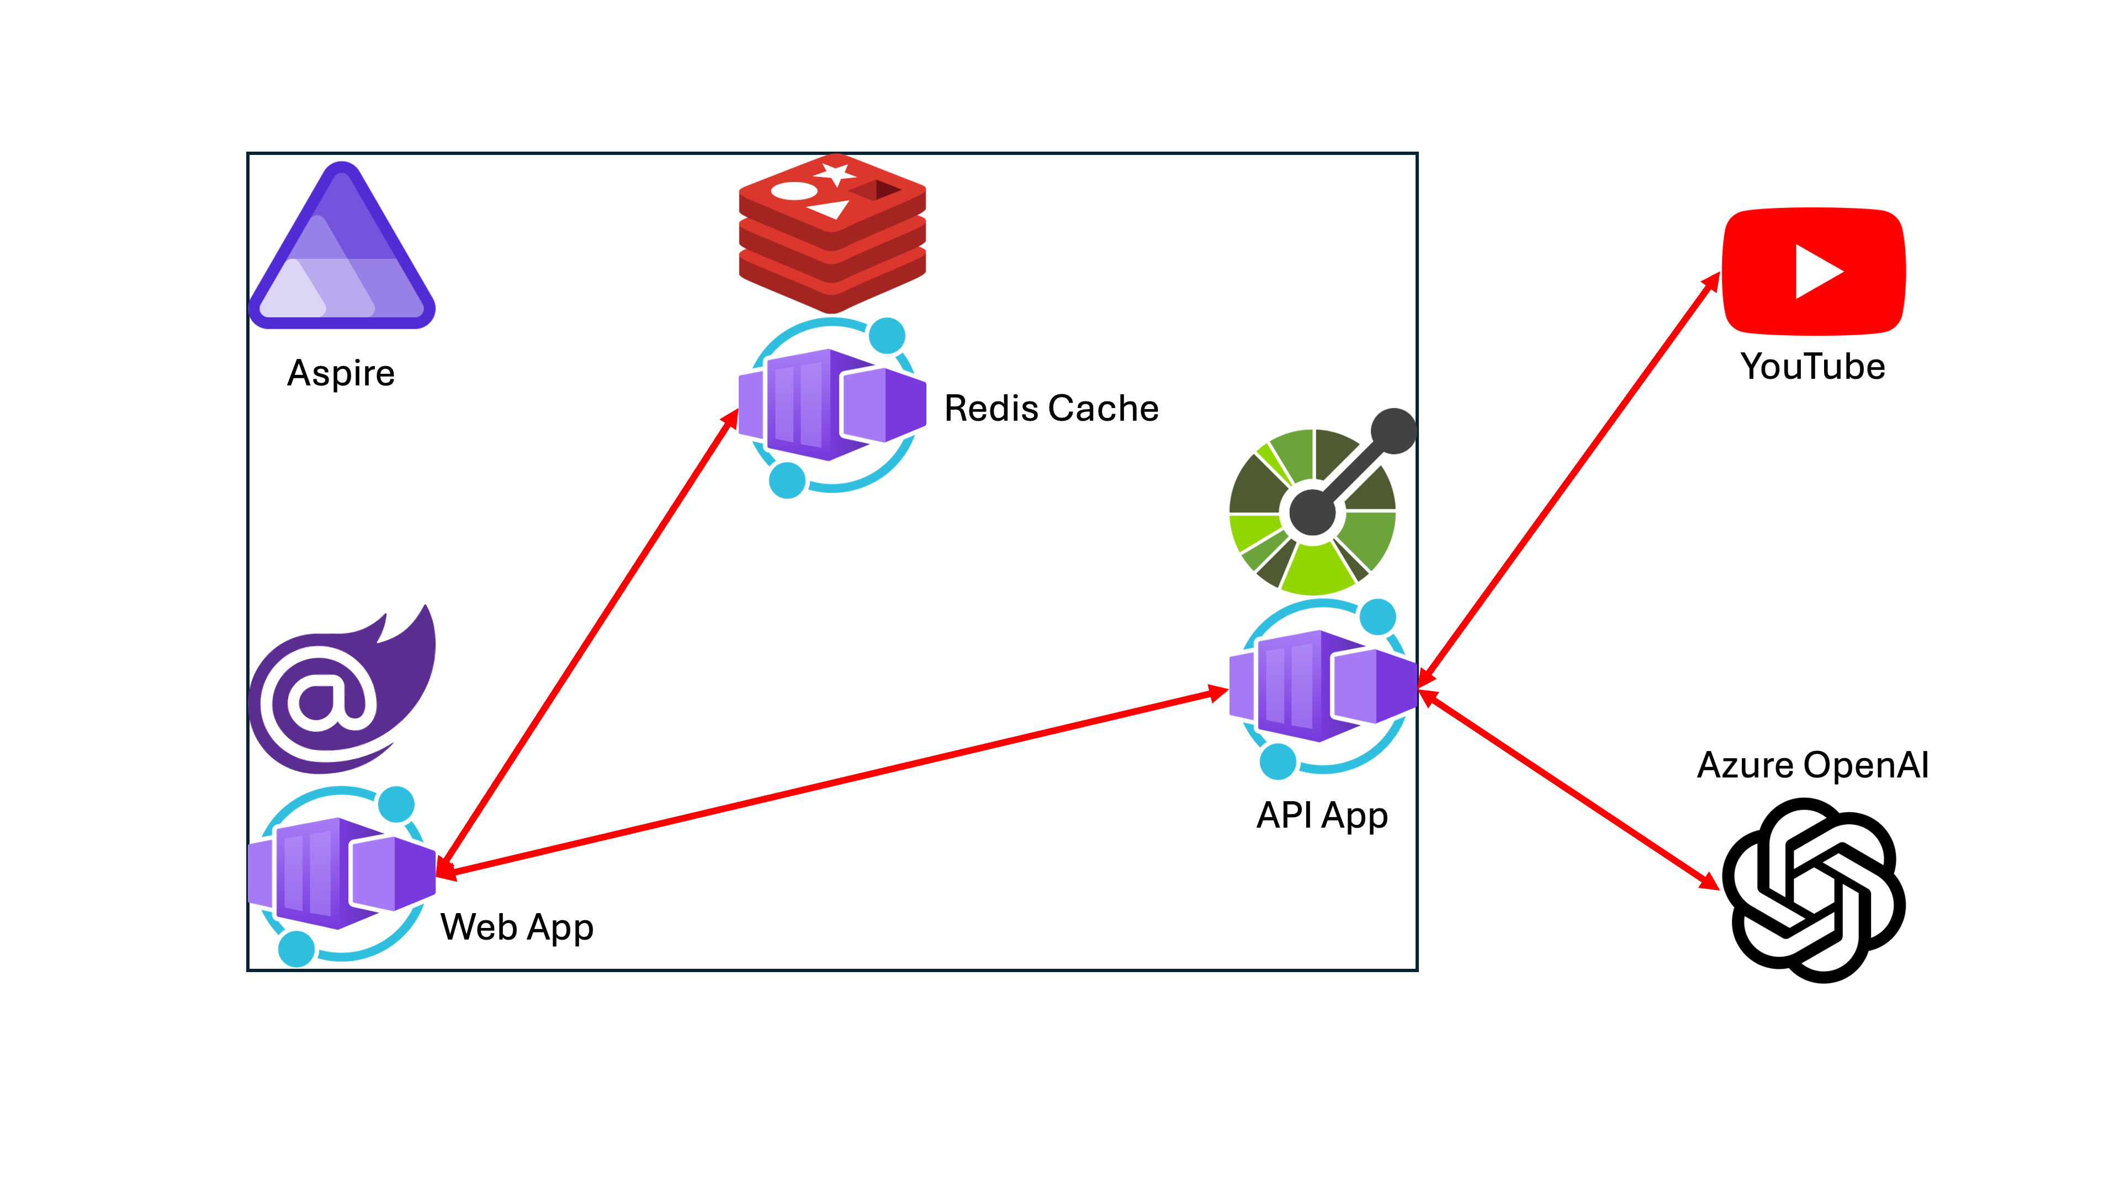

Slide 9
Let’s get started!
https://aka.ms/aspireinadaykr

